Slide 1
Natural Language Processing (NLP) & Automated Report
Moeen Kamali
Department of Mathematics
University of Kansas

Slide 2








Natural Language Processing
Main players and applications

Slide 3
Natural Language Processing
What is Natural Language Processing (NLP)?
NLP is the branch of computer science focused on developing systems that allow computers to communicate with people using everyday language.
The field of Natural Language Processing (NLP) is formed by Natural Language Understanding (NLU) and Natural Language Generation (NLG).

Slide 4




Natural Language Processing
What is Sentence Processing?
Natural Language
Understanding
Natural Language
Generation
Meaning
Text
Text
Speech Recognition
Speech
Synthesis
Speech
Speech

Slide 5
Natural Language Processing
Three aspects of the language: Syntax, Semantics, and Pragmatics
Syntax concerns the proper ordering of words and its affect on meaning.
The dog bit the boy.
The boy bit the dog.
Semantics concerns the (literal) meaning of words, phrases, and sentences.
“plant” as a photosynthetic organism/tree/ flower
“plant” as a manufacturing facility
“plant” as the act of sowing/farming
Pragmatics concerns the overall communicative and social context and its effect on interpretation.
The ham sandwich wants another beer.

Slide 6

Natural Language Processing
Word Sense Disambiguation (WSD)
Words in natural language usually have a fair number of different possible meanings:
For many tasks, such as generation and machine translation, the proper sense of each ambiguous word in a sentence must be determined.

Slide 7
Natural Language Processing
Part-Of-Speech (POS) tagging and Phrase Chunking
Part-of-speech tagging is the process of disambiguating the syntactic category of a word in context.
Phrase Chunking separates and segments a sentence into its sub elements: non-recursive noun phrase (NP) and verb phrase (VP).
I ate the spaghetti with meatballs.
Pro V Det N Prep N

Slide 8
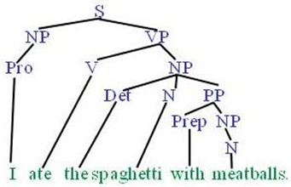
Natural Language Processing
Parsing (Syntactic Structure)
Parsing is a traditional grammatical exercise that involves breaking down a text into its component parts of speech with an explanation of the form, function, and syntactic relationship of each part.

Slide 9

Natural Language Processing
Anaphora Resolution and Co-Reference
Co-reference occurs when two or more expressions in a text refer to the same person or thing. They have the same “referent”.
Anaphora is the use of an expression the interpretation of which depends upon another expression in context
Determine which phrases in a document refer to the same underlying entity:

Slide 10

Natural Language Processing
Information Extraction (IE)
Identify phrases in language that refer to specific types of entities and relations in text.
Named entity recognition is task of identifying names of people, places, organizations, etc. in text.
Relation extraction identifies specific relations between entities

Slide 11
Natural Language Processing
Text Summarization
Produce a short summary of a longer document or article.
Article: With a split decision in the final two primaries and a flurry of super delegate endorsements, Sen. Barack Obama sealed the Democratic presidential nomination last night after a grueling and history-making campaign against Sen. Hillary Rodham Clinton that will make him the first African American to head a major-party ticket. Before a chanting and cheering audience in St. Paul, Minn., the first-term senator from Illinois savored what once seemed an unlikely outcome to the Democratic race with a nod to the marathon that was ending and to what will be another hard-fought battle, against Sen. John McCain, the presumptive Republican nominee….
Summary: Senator Barack Obama was declared the presumptive Democratic presidential nominee.

Slide 12
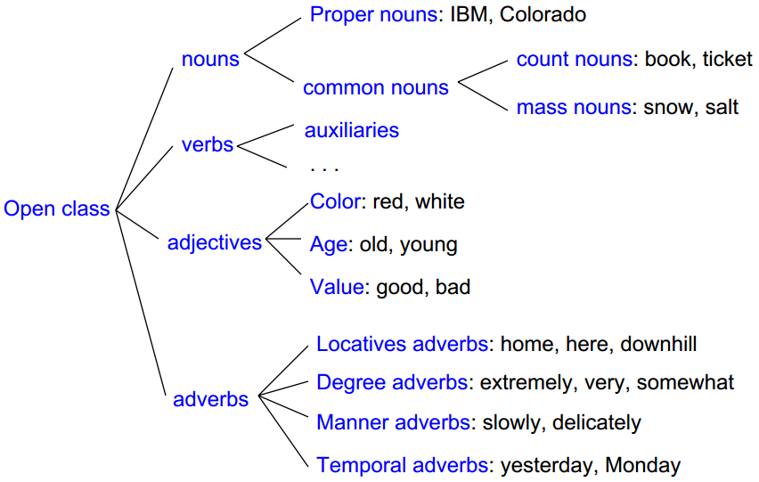
Natural Language Processing
English sentence structure and classes

Slide 13
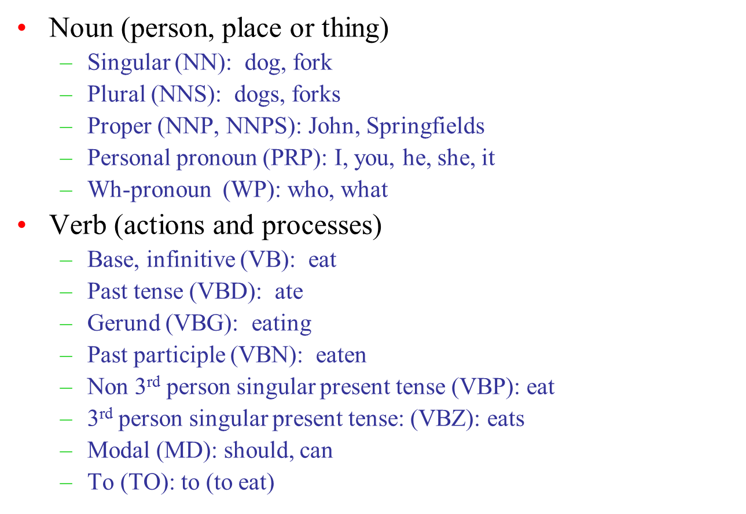
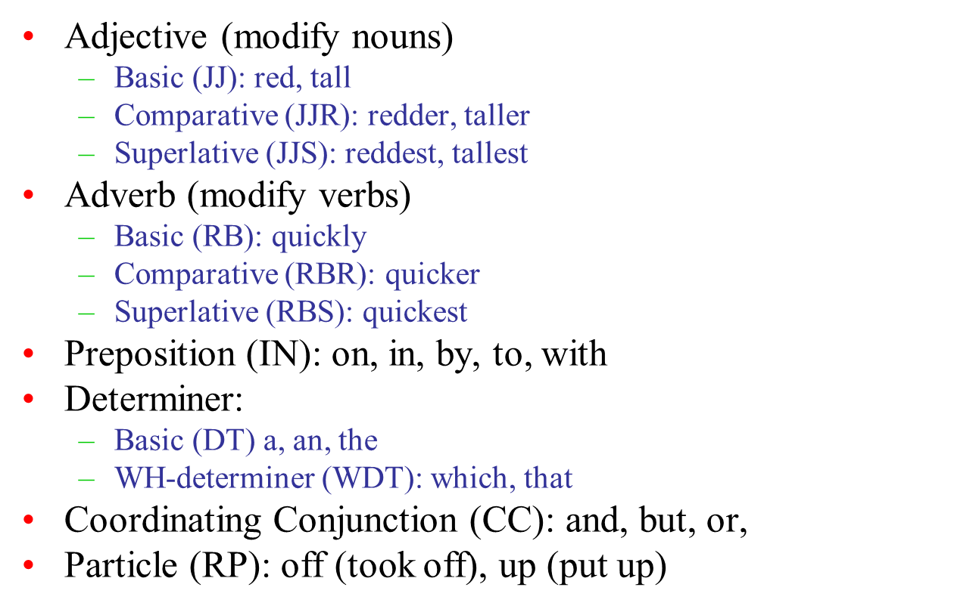
Natural Language Processing
UPenn Treebank set of 45 tags is the most common in NLP today

Slide 14

Natural Language Processing
Modular Comprehension
Acoustic/
Phonetic
Syntax
Semantics
Pragmatics
sound waves
words
parse trees
literal
meaning
meaning (contextualized)

